Slide 1

Implementing transformers for casual language modeling for word suggestion on TD Clari
Sarah Sinha

Slide 2
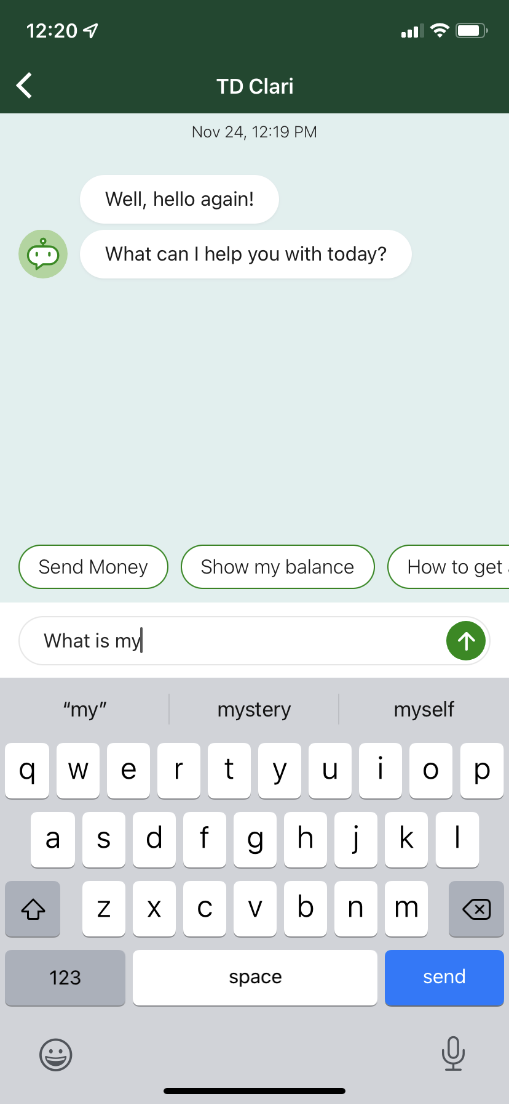
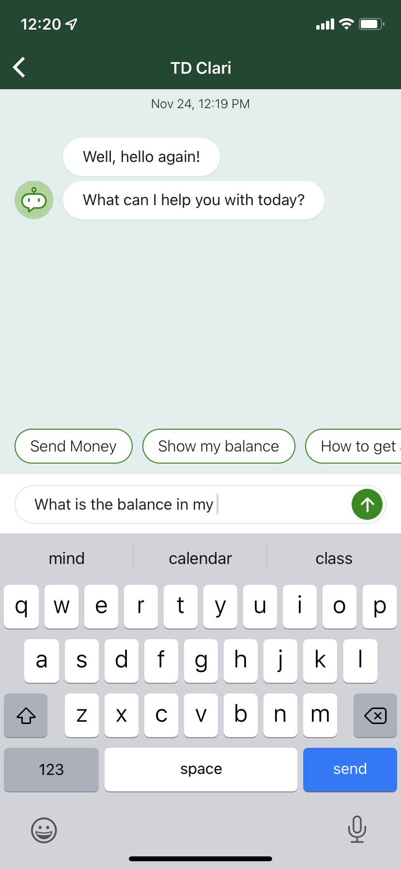
The Problem
TD Clari uses the built in Apple keyboard for next word prediction. As a result, generated words aren’t relative to the banking domain.
This provides a missed opportunity to think like a customer. Fine tuning transformers for casual language modelling for the banking domain will help less financially literate customers convey utterances more effectively.

Slide 3
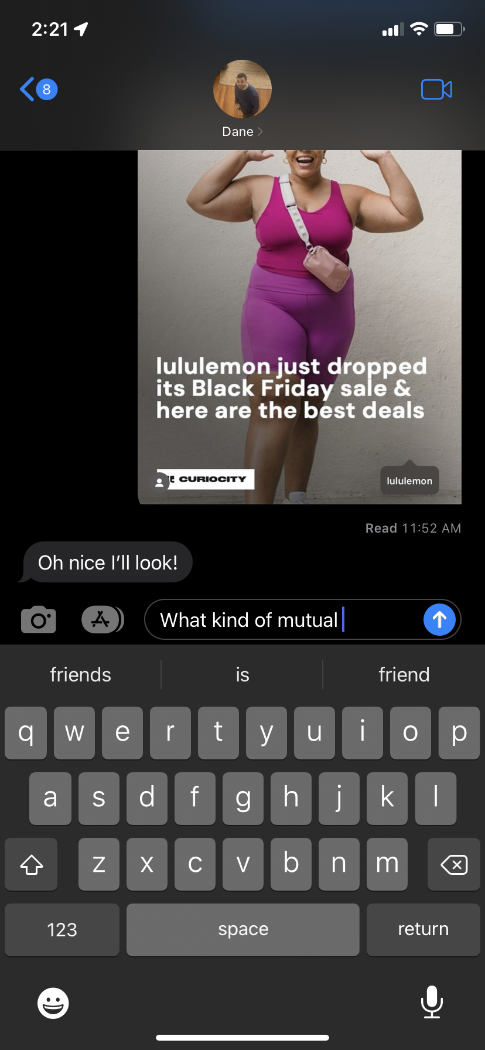
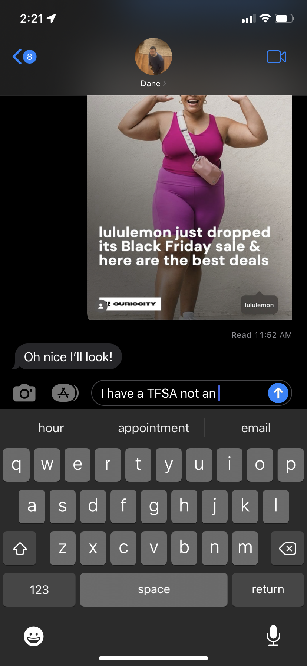
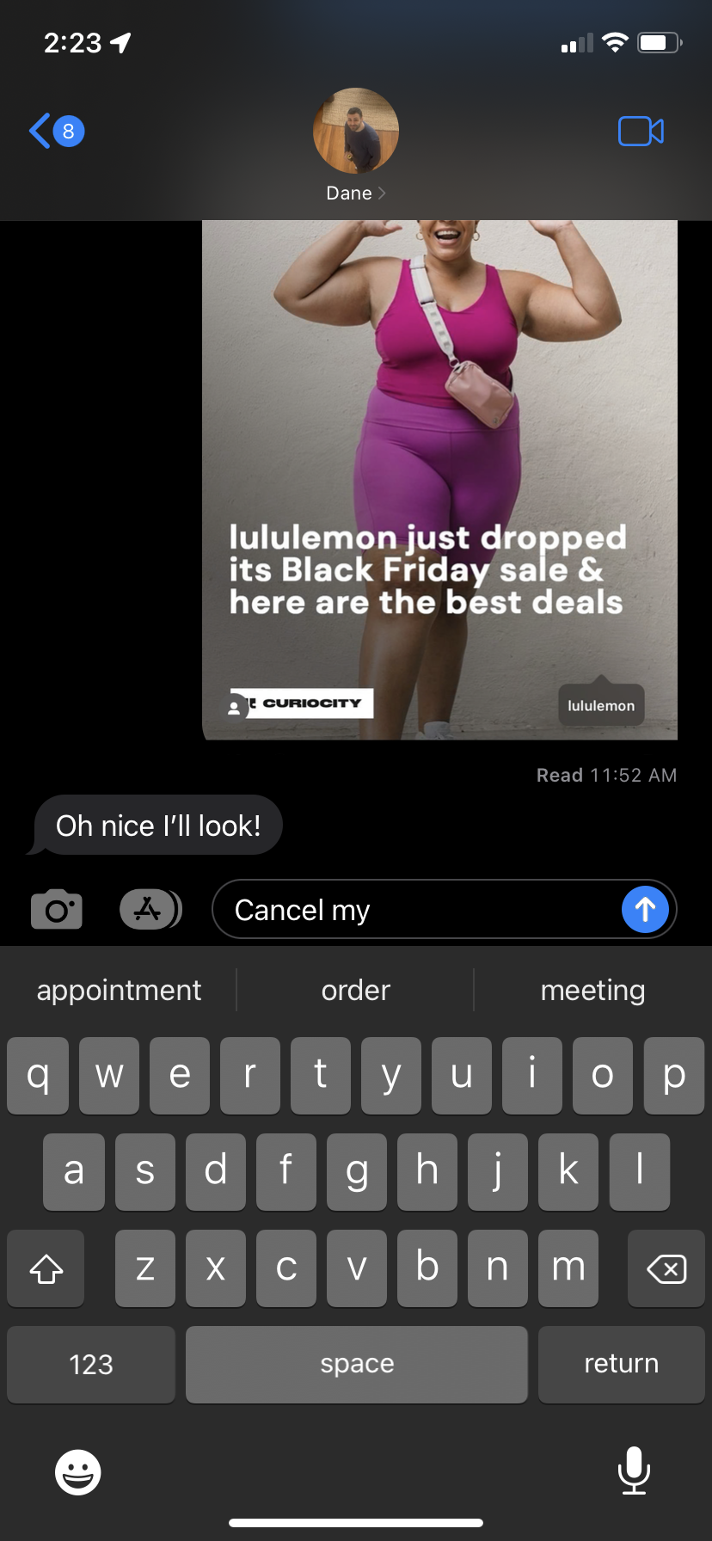

Slide 4
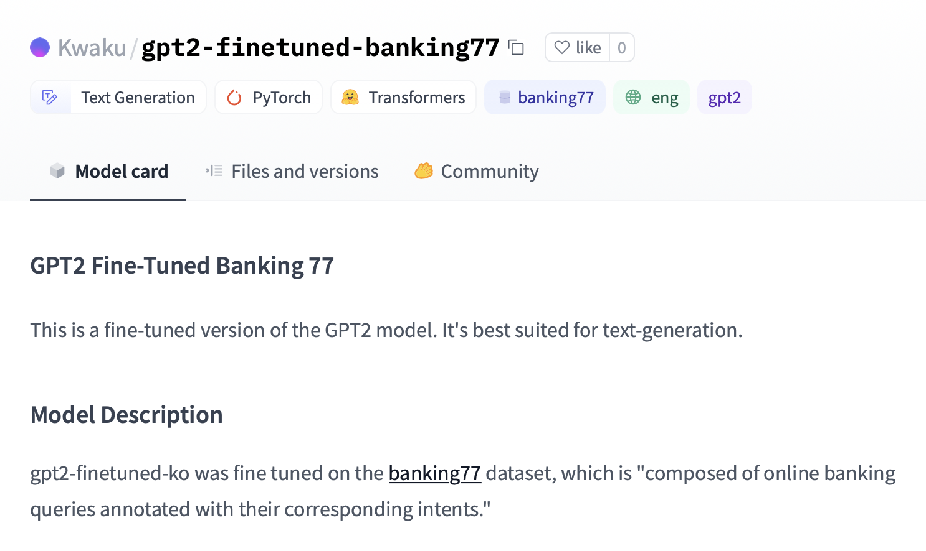
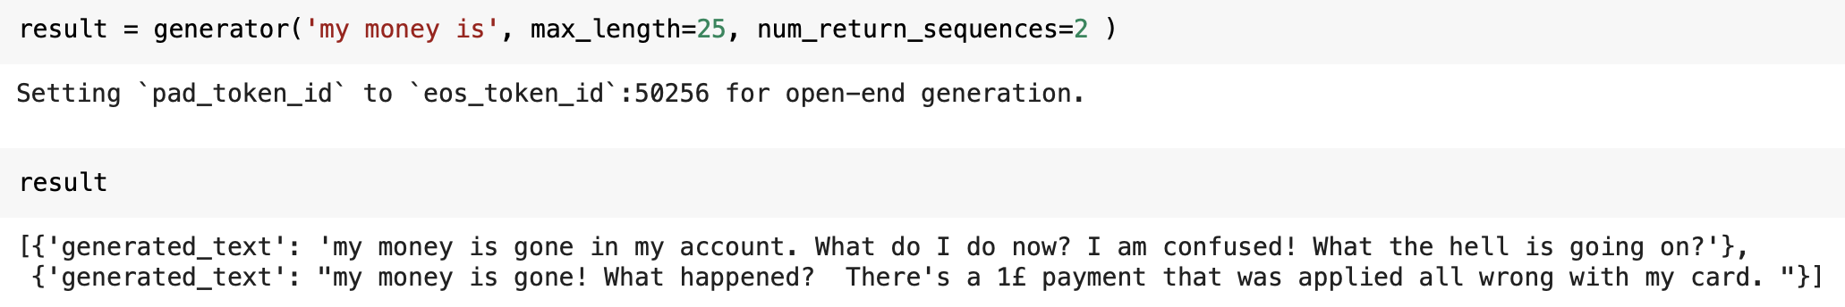
Current Landscape
One open source model fine tuned on banking CB data (which has issues –see below)
Many banking models but for other NLP tasks – eg. Financial sentiment analysis, classification, etc.

Slide 5
Dataset – Banking FAQ Bot
Do I have the option to structure my loan as partly fixed or partly floating?
What is the maximum tenure to repay the Loan Against Property

Slide 6
Preprocessing
HDFC → TD
Random capitalizations

Slide 7
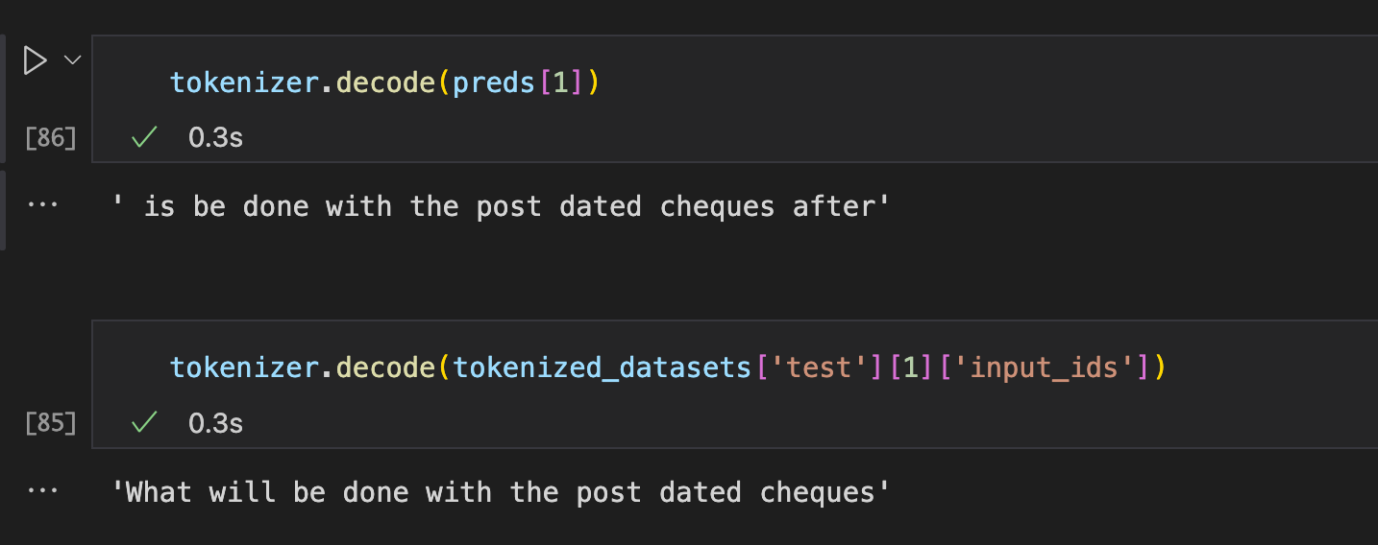
Results

Slide 8
Next Steps
Step away from training API to add more customization
Lr scheduler
Optimizer
Epochs
Train on TD data
Models attending to whole conversations (DialogueRNN)

Slide 9
Problems

